Slide 1
CAPSTONE PROJECT
Design and implementation of lexical analyzer
NAME : S PURUSHOTHAM
REG NO:192211671
NAME :S. Tanveer
REG NO:192211443
NAME :L. Venkata Sai.
REG NO :192210403
PROJECT GUIDE: DR.G.MIVHEAL

Slide 2


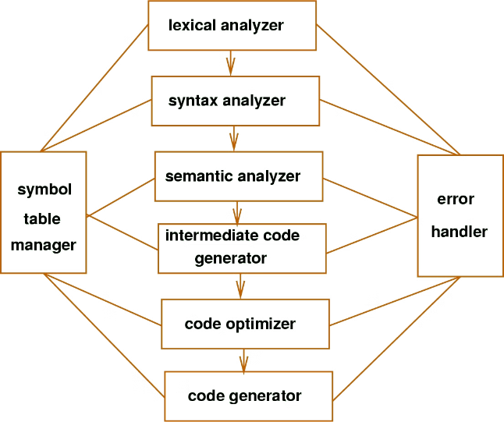

Introduction to Lexical Analysis
Lexical analysis is the first stage of the compilation process, where a program's source code is scanned and broken down into a sequence of tokens. This foundational step sets the stage for deeper semantic analysis and code generation.

Slide 3

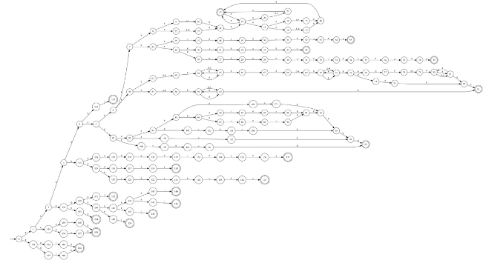
Role of Lexical Analyzer in Compilers
1
Tokenization
The lexical analyzer identifies and classifies the basic elements, or tokens, within the source code.
2
Pattern Matching
It matches the input characters against predefined patterns to determine the appropriate token type.
3
Error Detection
The analyzer also identifies and reports any lexical errors, such as invalid characters or improperly formed identifiers.

Slide 4
Lexical Analysis Process
Scanning
Pattern Matching
Token Generation
The lexical analyzer reads the input character by character, processing the stream into a sequence of tokens.
The analyzer compares the input against predefined patterns to determine the appropriate token type.
Once a valid token is recognized, it is passed to the next stage of the compiler for further processing.

Slide 5

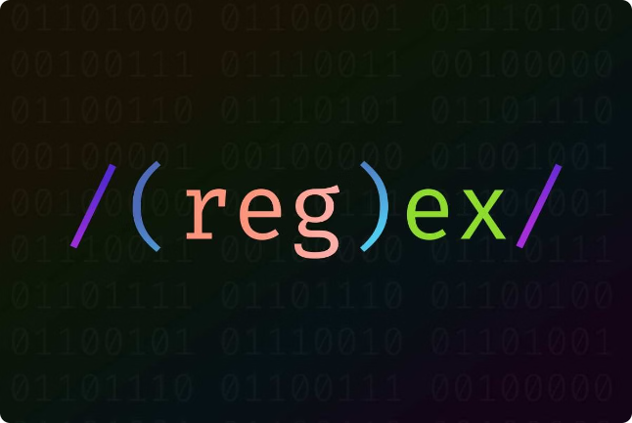
Tokens, Lexemes, and Regular Expressions
Tokens
Lexemes
Tokens are the basic building blocks of a programming language, such as keywords, identifiers, and operators.
Lexemes are the actual character sequences that represent the token, as found in the source code.
Regular Expressions
Regular expressions are a powerful tool used to define and match patterns of characters, which are essential for lexical analysis.

Slide 6

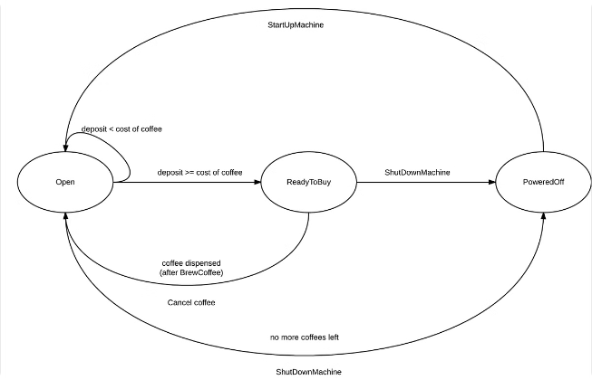
Finite State Automata and Their Construction
1
States
A finite state automaton is a mathematical model consisting of a set of states and transitions between them.
2
Transitions
The automaton moves from one state to another based on the input characters, following predefined transition rules.
3
Acceptance
When the automaton reaches an accepting state, it has successfully recognized a valid token or lexeme.

Slide 7

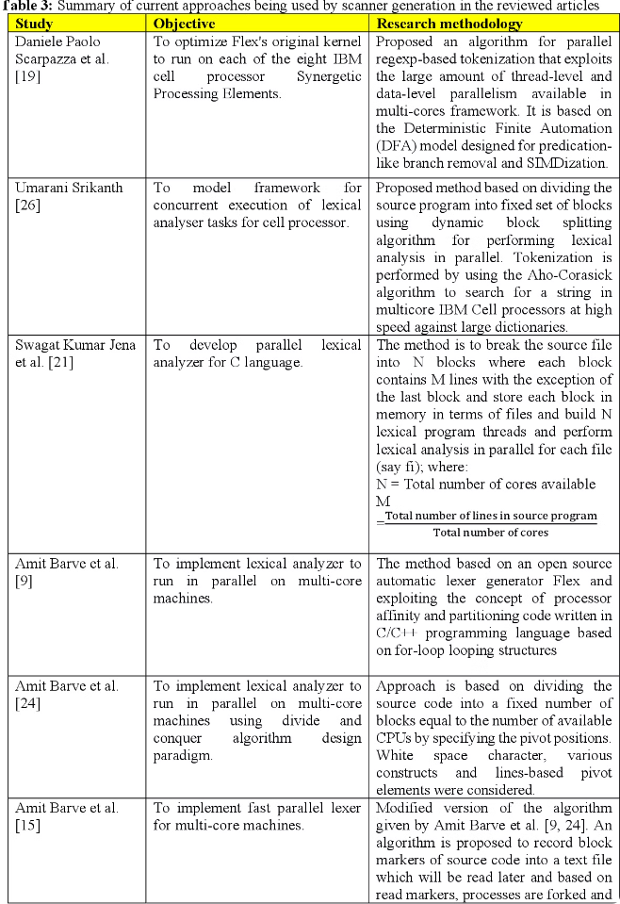



Implementation of Lexical Analyzer Using Finite State Automata
Automata Construction
The lexical analyzer is implemented by building a finite state automaton that can recognize and classify the various token types.
Table-Driven Approach
The automaton's behavior is typically encoded in a transition table, allowing for efficient and flexible implementation.
Optimization
The automaton can be optimized to minimize the number of states and transitions, improving the analyzer's performance.

Slide 8


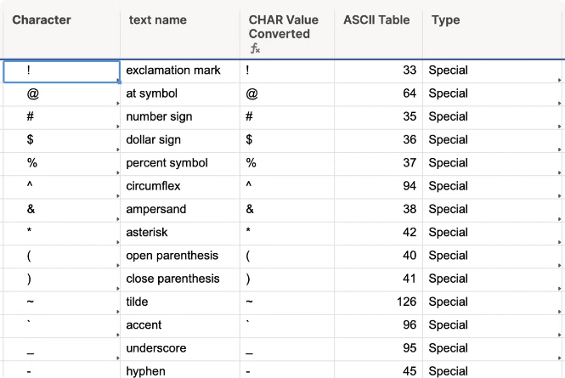


Handling of Special Characters and Reserved Keywords
Special Characters
The lexical analyzer must recognize and properly handle a wide range of special characters, such as punctuation and operators.
Reserved Keywords
It must also identify and classify the reserved keywords of the programming language, ensuring they are not treated as identifiers.
Symbol Tables
The analyzer often maintains symbol tables to efficiently store and retrieve information about identified tokens.

Slide 9


Error Handling and Recovery in Lexical Analysis
1
Invalid Characters
2
Unclosed Constructs
The lexical analyzer must detect and report any invalid or unexpected characters in the input stream.
It must also handle cases where lexical constructs, such as strings or comments, are not properly terminated.
3
Error Recovery
The analyzer should provide mechanisms for recovering from errors and continuing the compilation process, if possible.

Slide 10


Optimization Techniques for Lexical Analysis
Technique
Description
DFA Minimization
Reducing the number of states in the finite state automaton to improve performance.
Backtracking Elimination
Avoiding unnecessary backtracking in the lexical analyzer to enhance efficiency.
Precomputation
Precomputing and storing frequently used data to speed up the analysis process.

Slide 11

Conclusion and Future Directions
1
Robust Lexical Analysis
2
Adaptive Techniques
3
Integrated Approaches
Lexical analysis is a crucial foundation for compilers and interpreters, and continued research aims to improve its accuracy, speed, and robustness.
Future developments may explore more adaptive and context-aware lexical analysis strategies to handle evolving programming language features.
Integrating lexical analysis with higher-level compiler stages can lead to more efficient and holistic compilation processes.

